Slide 1
Social Buzz: Analyzing Top 5 Categories
We'll take a deep dive into Social Buzz's top content categories. Our team of experts analyzed over 36 million pieces of content to uncover insights.

Slide 2

Project Recap
Founding
Anonymity
Two former engineers from a large social media conglomerate started Social Buzz.
Social Buzz emphasizes content by keeping all users anonymous.
Accenture POC
Accenture analyzed their big data practice, gave recommendations for a successful IPO, and highlighted the top 5 categories with the largest aggregate popularity.

Slide 3

The Problem
1
Volume
2
Diversity
Over 100,000 pieces of content are posted per day. That's 36,500,000 pieces of content per year!
The content includes everything from text to images, videos, and GIFs.
3
Analysis
We've analyzed the top 5 categories with the largest aggregate popularity.

Slide 4



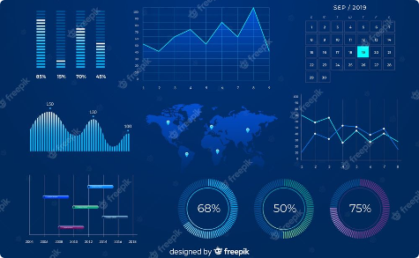
The Analytics Team
Andrew Fleming
Marcus Rompton
Chief Technical Architect
Senior Principle
Vaibhav Sharma
Data Analyst

Slide 5

The Process
Data Cleaning
Data Analysis
Clean the data to prepare it for analysis.
Analyze the data and identify patterns.
1
2
3
4
5
Data Understanding
Data Modelling
Uncover Insights
Create models to understand the data.
Discover insights that can help Social Buzz improve its content strategy.
Get to know the data and identify any potential issues.

Slide 6
Unique categories are:
Animals
Science
Healthy Eating
Technology
Food
Culture
Travel
Cooking
Soccer
Education
Fitness
Studying
Dogs
Tennis
Veganism
Public Speaking

Slide 7

Top 5 Categories with reaction:
Category
Reaction
Animals
74965
Science
71168
Healthy Eating
69339
Technology
68738
Food
66676

Slide 8

Thank You!
Thank you for joining us on this journey to uncover insights from Social Buzz's big data. We hope you learned something new and exciting.
Name :- Vaibhav Sharma

